Slide 1
Joli
Xiaoqing Zhang 1001778506
Zizhen Li 1001780922
Yujia Shi 1001778273

Slide 2
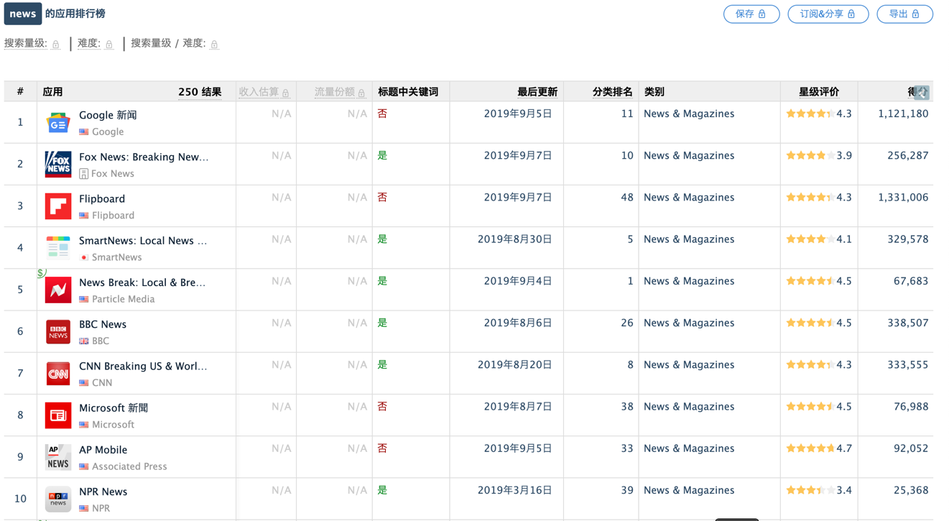
Competitor analysis
Top 10 US news app
Data Sources： App Annie
Downloads and new update time data source: google play

Slide 3
Competitor analysis
Name: Google news
Downloads : More than 1 billion downloads
Last Updated: August 4, 2019
Type: Aggregate
Features:
Respect for user anti-interference;
Main local news;
Real-time updates;
Support for national and language rich.

Slide 4
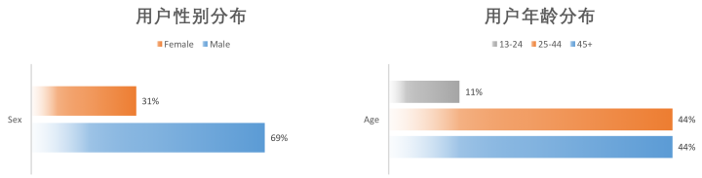
Competitor analysis
Google news
User gender distribution and user age distribution

Slide 5
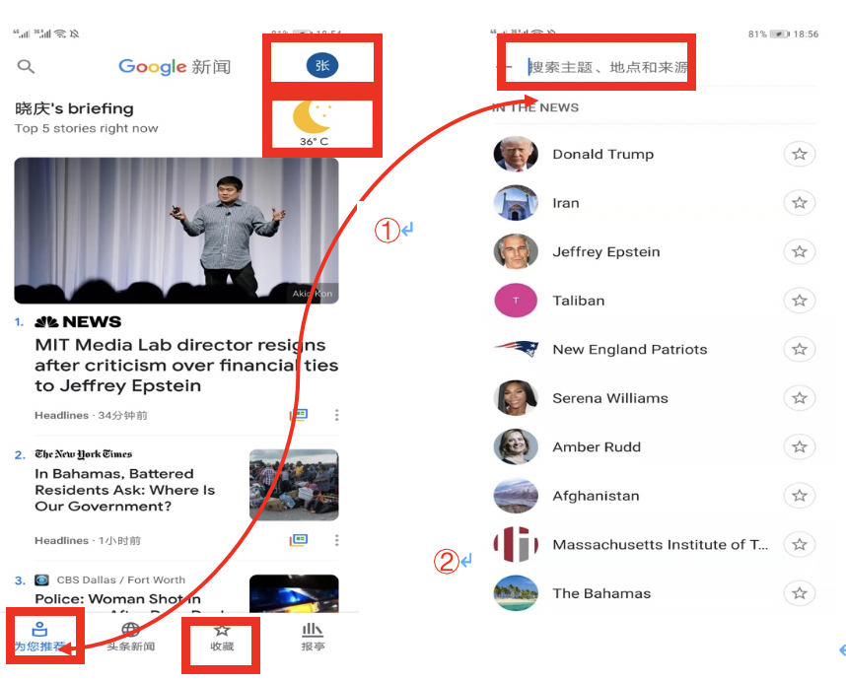
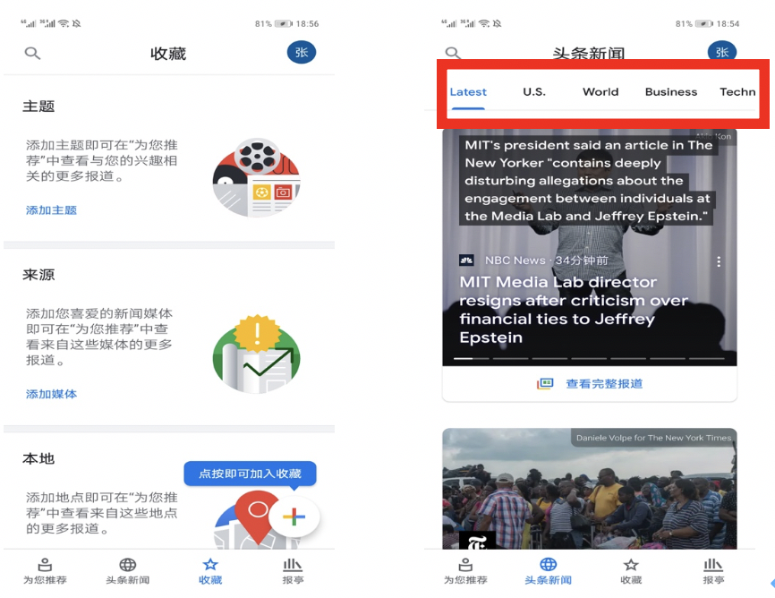
Competitor analysis
The interface takes a vertical layout and contains 8 categories
Google news
②

Slide 6
Competitor analysis
Name: FOX News
Downloads : Exceeded 10 million times
Last Updated: July 8, 2019
Type: Tradition
Features:
Old TV channels, rich TV channels;
Respect user privacy;
News channels subdivided into three levels of multi-directional news stories, news anchors.

Slide 7
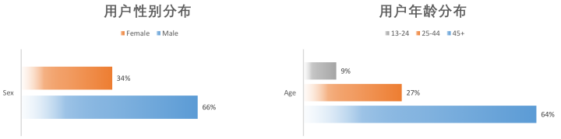

Competitor analysis
FOX News:
User gender distribution and user age distribution

Slide 8
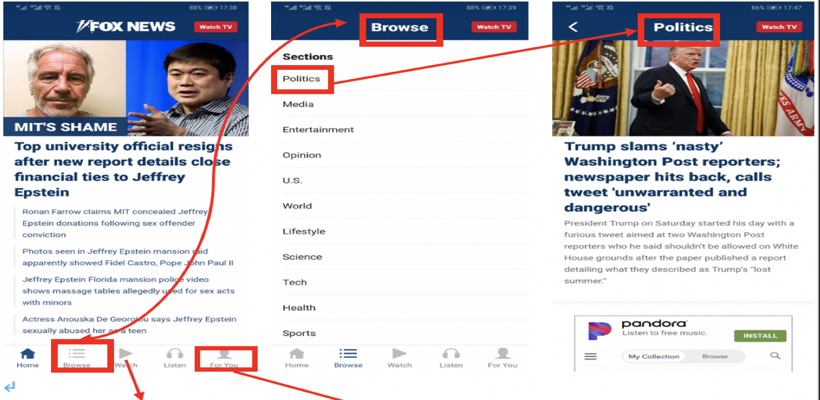
Competitor analysis
FOX News
②
①
Three-level menu structure

Slide 9
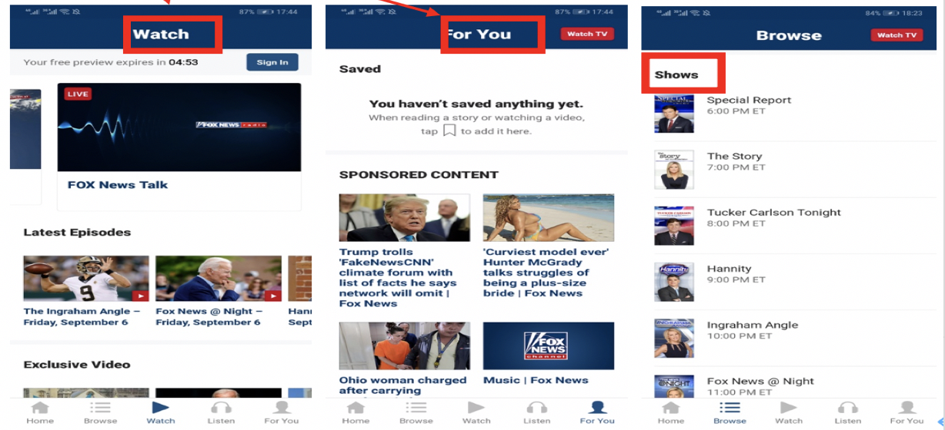
Competitor analysis
FOX News
Feature：watch
subscription
shows

Slide 10
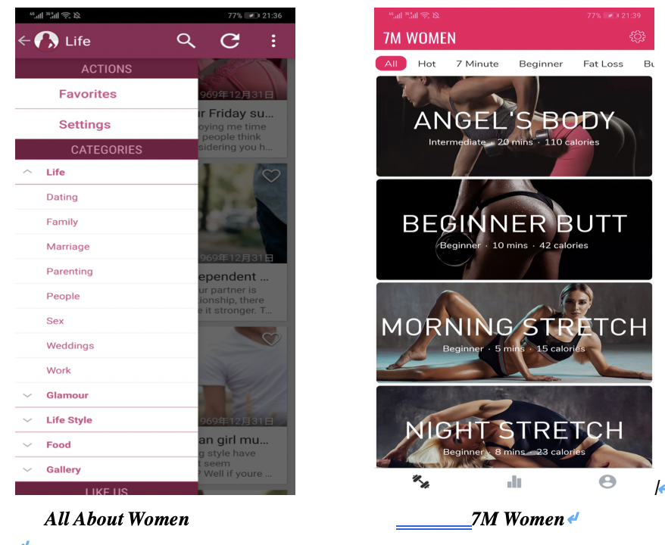
Competitor analysis
Three levels of options
Many modules
The amount of data in the app is large
loading will cause the interface to be stuck and the data is not real-time
Can not meet the needs of women in the current society.
only for women's fitness.
The content is not comprehensive enough.

Slide 11
Risks
P_{R} | E_{R} | R_{E} | Description | How to solve
80% | 36h | 28.8 | Data collection. | Collecting all aspects of the API.
70% | 30h | 21 | The data is not attractive enough. | Using a good performance recommendation algorithm
30% | 20h | 6 | The app is not smooth enough. | Refactoring code structure.
20% | 20h | 4 | The UI is not beautiful enough. | Going to learn the UI well-received app.

Slide 12
Thanks for your listening

